Slide 1
Neural Network and Natural Language Processing

Slide 2
Artificial neural network
Basic components of artificial neural network are:
  Neurons (Nodes)
  Layers
  Connections
  Activation function
In neurons some values or data is stored.

Slide 3
W1b
Output layer
Input layer
Neurons/nodes

Slide 4
x1
x1
w1
Y
y
w2
x2
x2
Y=w1*x1+w2*x2
Sigmod function is used as activation function
So σ(y) = 1/(1 + e^{−y})

Slide 5
For eg
  w1 =0.5
  W2=-0.3
  b=0.1
This value is taken after number of training in neural network.

Slide 6
Activation function: the process of deciding output after aggregating input is called activation function.
Types:
Linear function: for linear activation function, the output activity is proportional to the total weighted output.
  g(x)=k*x+c, where k and c are constant.
Threshold function: for threshold function, the output are set at one of the two levels, depending on whether the total input is greater than or less than some threshold value.
  g(x)=1, if x>-=k
  g(x)=0, if x<k
Sigmoid function: For sigmoid activation function, the output varies continuously but not linearly as the input changes.
  σ(y) = 1/(1 + e^{−y})

Slide 7
Types of ANN
Feed-forward network:
  feed-forward ANN allows signal to travel one way only: from input to output.
  There is no feedback( loops) i.e the output of any layer doesnot affect the same layer.
  This type of ANN are extensively used in pattern recognization.
outputs
inputs

Slide 8
Example of feedforward
g3=g(w1,3 *a1 +w2,3 *a2)
a1
W1,3
a3
W3,5
a5
g4=g(w1,4 *a1 +w2,4 *a2)
W1,4
W2,3
a4
W4,5
g5=g(w3,5 *a3 +w4,5 *a4)
a2
W2,4

Slide 9
Feedback networks (recurrent networks)
Feedback networks can have signal travelling in both direction by introducing loops in the network.
inputs
outputs

Slide 10
Application of ANN
Image and Video Processing:
  Applications:
  Face recognition (e.g., Facebook photo tagging)
  Object detection (e.g., autonomous vehicles)
  Medical imaging (e.g., tumor detection in X-rays or MRIs)
Natural Language Processing (NLP):
  Applications:
  Machine translation (e.g., Google Translate)
  Text classification (e.g., spam detection)
  Sentiment analysis (e.g., product reviews)
Speech Recognition and Audio Processing:
  Applications:
  Voice assistants (e.g., Google Assistant, Alexa)
  Automatic transcription (e.g., YouTube captions)

Slide 11
Healthcare and Bioinformatics:
  Applications:
  Disease prediction (e.g., cancer, diabetes)
  Drug discovery
Finance and Banking
  Applications:
  Stock market prediction
  Credit scoring
  Fraud detection

Slide 12
Boltzmann Machine (BM)
A Boltzmann Machine is a type of stochastic recurrent neural network that uses a probabilistic approach to model data distributions i.e Instead of memorizing the training data, the Boltzmann Machine learns how likely different patterns are.
It is mainly used for unsupervised learning, meaning it learns patterns from input data without requiring labeled outputs.
It consists of a set of neurons connected in a network, where each neuron can take binary states (0 or 1).
These networks are energy-based models that learn by minimizing an energy function, similar to how physical systems reach equilibrium.

Slide 13
Low energy → Stable and more likely.
High energy → Unstable and less likely.

Slide 14
Concepts of natural language understanding and natural language generation
Natural Language Processing (NLP) is divided into two major areas:
  Natural Language Understanding (NLU) – Understanding human language.
  Natural Language Generation (NLG) – Generating human language.
Natural Language Understanding (NLU) is the branch of AI that enables a computer to understand the meaning of human language (text or speech).
It converts human language → machine-understandable representation.
Example
Input:
"Book me a flight from Kathmandu to Pokhara tomorrow."
The computer should understand:
Intent: Book flight
Source: Kathmandu
Destination: Pokhara
Date: Tomorrow
The computer does not simply see words—it understands what they mean.

Slide 15
Natural Language Generation (NLG) is the branch of AI that converts machine data or internal representations into human-readable language.
It converts machine representation → human language.
Example
Computer data:
Temperature = 35°C Weather = Sunny
Generated sentence:
"Today's weather is sunny with a temperature of 35°C."

Slide 16
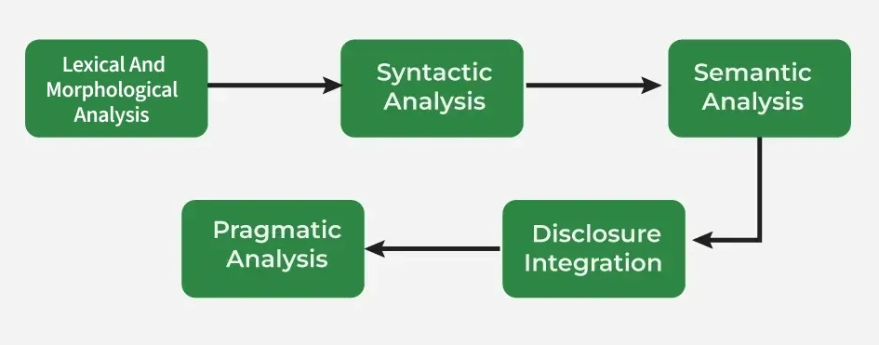
Steps in Natural Language Processing

Slide 17
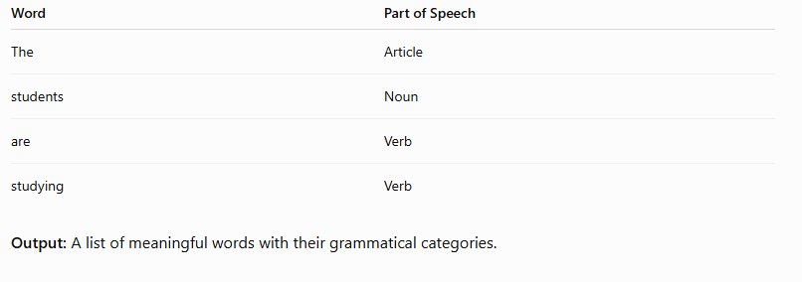
Lexical Analysis (Word-Level Analysis)
Lexical analysis is the first step of NLP. It breaks the input sentence into words or tokens and identifies their basic properties.
Example
Sentence:
"The students are studying."
After lexical analysis:

Slide 19
Morphological Analysis
Morphological analysis studies the internal structure of words using morphemes, the smallest units of meaning.
Stemming reduces words to their root form like "running" to "run".
Lemmatization converts words to their base or dictionary form considering the context like "better" becomes "good".

Slide 20
Syntactic Analysis (Parsing)
Syntactic analysis checks whether the sentence follows the grammatical rules of the language and determines the relationship between words.
Example
Sentence:
"Ram eats an apple."
Structure:
Subject : Ram
Verb : eats
Object : apple
If the sentence is:
"Apple Ram eats"
The parser recognizes that the word order is grammatically incorrect in English.
Output: The grammatical structure of the sentence.

Slide 21
Semantic Analysis (Meaning Analysis)
Semantic analysis determines the meaning of the sentence after its grammatical structure has been identified.
Example
Sentence:
"Ram drinks water."
Computer understands:
Person : Ram, Action : Drink, Object : Water
Another example:
"The bank is closed."
Semantic analysis tries to determine whether bank means:
A financial institution, or
The side of a river.
Output: The meaning of the sentence.

Slide 22
Discourse Integration
Discourse integration connects the current sentence with previous sentences to understand the overall context.
Example
Ram bought a laptop. He uses it every day.
The computer identifies:
He → Ram
it → Laptop
Without discourse analysis, the pronouns would be ambiguous.
Output: Context-aware understanding across multiple sentences.

Slide 23
Pragmatic Analysis
Pragmatic analysis determines the speaker's intended meaning using context, background knowledge, and real-world situations.
Teacher says:
"Can you open the window?"
Literal meaning:
  Asking whether the student has the ability.
  Actual meaning:
  A polite request to open the window.

